Slide 1
Chapter 14 Enterprise Computing

Slide 2
Chapter 14 Objectives
Discuss the special information requirements of an enterprise-sized corporation
Describe the major types of e-commerce
Identify information systems used in the functional units of an enterprise
Discuss the computer hardware needs and solutions for an enterprise
List general purpose and integrated information systems used throughout an enterprise
Determine why computer backup is important and how it is accomplished
List types of technologies used throughout an enterprise
Discuss the steps in a disaster recovery plan
Next

Slide 3
What is Enterprise Computing?
What is an enterprise?
Large organization such as multinational corporation, university, hospital, research laboratory, or government organization
Requires special computing solutions because of its size
Enterprise computing—use of computers in networks that encompass variety of operating systems, protocols, and network architectures
p. 714
Next

Slide 4
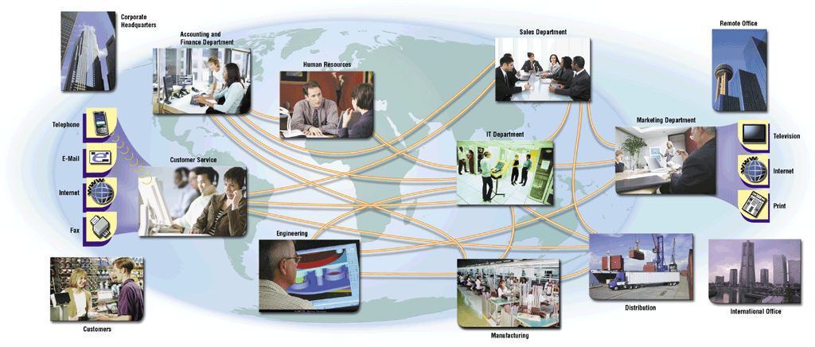
What is Enterprise Computing?
How does information flow within an enterprise?
Enterprise manages large amounts of information over an extensive geographical area and disparate groups of people
p. 714 Fig. 14-1
Next

Slide 5
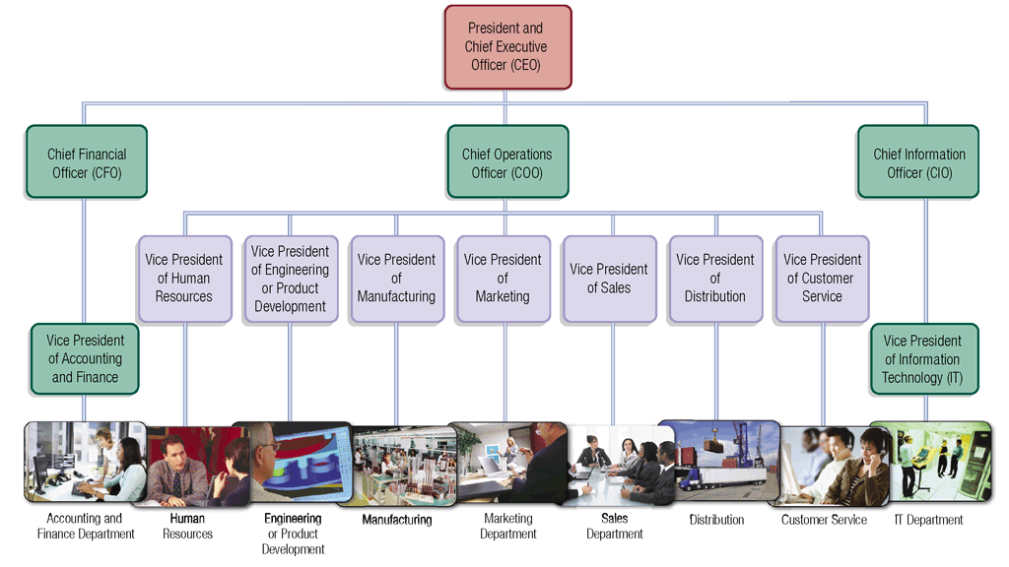
What is Enterprise Computing?
How are enterprises organized?
Most are organized in a hierarchy
p. 716 - 717 Fig. 14-2
Next

Slide 6
What is Enterprise Computing?
What are the four categories of users?
Executive Management
Middle Management
Operational Management
Nonmanagement Employees
p. 717 Fig. 14-3
Next

Slide 7
What is Enterprise Computing?
What is enterprise information?
Information gathered in ongoing operations of enterprise
Collected, combined, and analyzed over time
Allows managers to make better decisions
p. 718
Next

Slide 8
What is Enterprise Computing?
What are the four management activities?
1. Planning objectives strategies tactics
2. Organizing money people management structure
3. Leading communications instructions motivation
4. Controlling performance measurement corrective action
p. 719 Fig. 14-4
Next

Slide 9
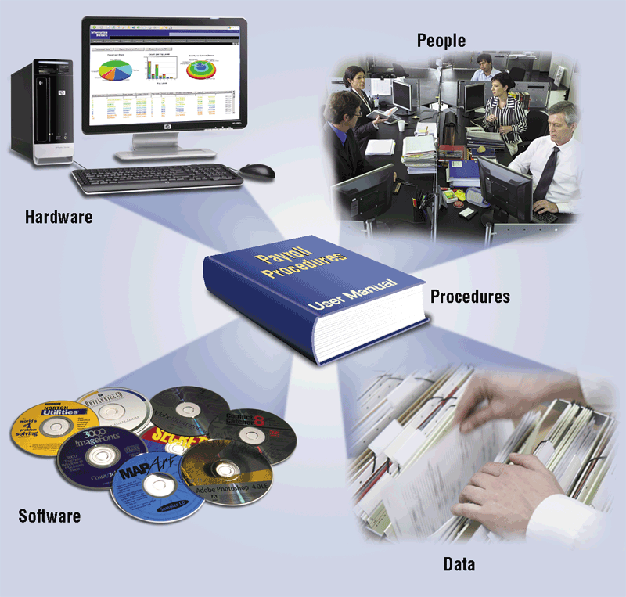
Information Systems in the Enterprise
What is an information system?
Set of hardware, software, data, people, and procedures that works together to produce information
Procedures are instructions users follow to accomplish activities
Click to view Web Link, click Chapter 14, Click Web Link from left navigation, then click Information Technology Departments below Chapter 14
p. 719 - 720 Fig. 14-5
Next

Slide 10
Information Systems in the Enterprise
What is a functional unit?
Individual operating entity, which can include departments, centers, and divisions
Accounting and Finance
Human Resources (HR)
Engineering or Product Development
Manufacturing
Marketing
Sales
Distribution
Customer Service
Information Technology
p. 720
Next

Slide 11
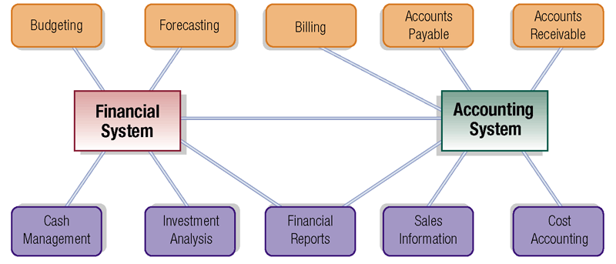
Information Systems in the Enterprise
What are the functions of accounting and finance systems?
p. 721 Fig. 14-7
Next

Slide 12
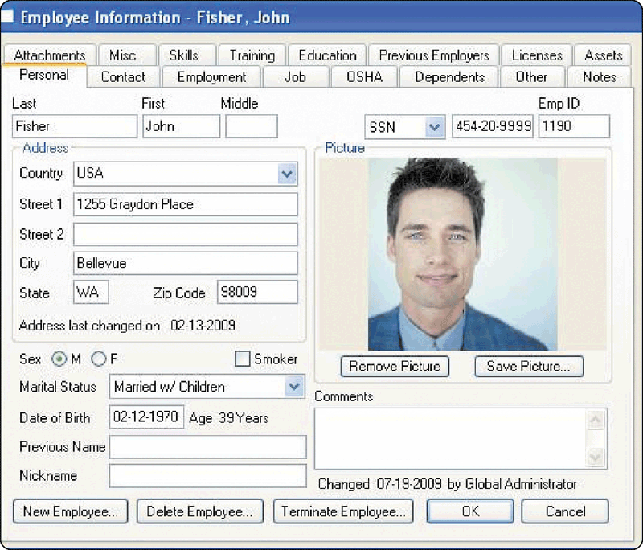
Information Systems in the Enterprise
What is a human resources information system (HRIS)?
Manages human resources functions
Employee relationship management (ERM) system facilitates communication with employees
Click to view Web Link, click Chapter 14, Click Web Link from left navigation, then click Employee Relationship Management below Chapter 14
p. 721 Fig. 14-8
Next

Slide 13
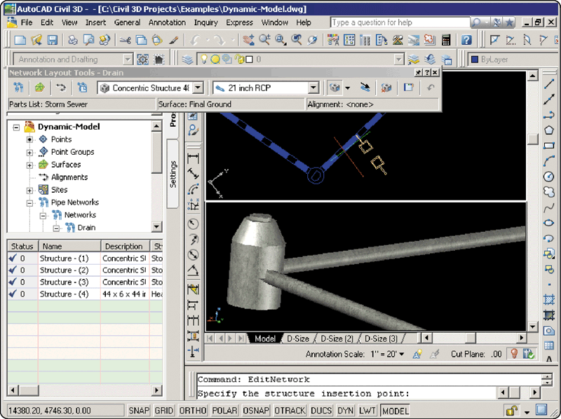
Information Systems in the Enterprise
What is computer-aided design (CAD)?
Uses special software to aid in product design
Computer-aided engineering (CAE) uses computers to test product designs
p. 722 Fig. 14-9
Next

Slide 14
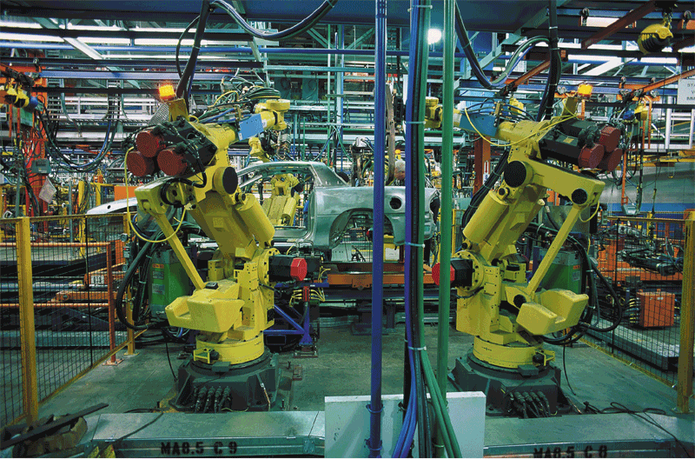
Information Systems in the Enterprise
What is computer-aided manufacturing (CAM)?
Use of computers to control production equipment
Computer-integrated manufacturing (CIM) integrates operations of manufacturing process
p. 722 - 723 Fig. 14-10
Next

Slide 15
Information Systems in the Enterprise
What is Material Requirements Planning (MRP)?
Uses software to monitor and control production processes
Focuses on inventory of parts
Manufacturing Resource Planning II (MRP II) is extension of MRP
Helps in scheduling, tracking production, and monitoring product quality
Click to view Web Link, click Chapter 14, Click Web Link from left navigation, then click MRP II below Chapter 14
p. 722 - 723
Next

Slide 16
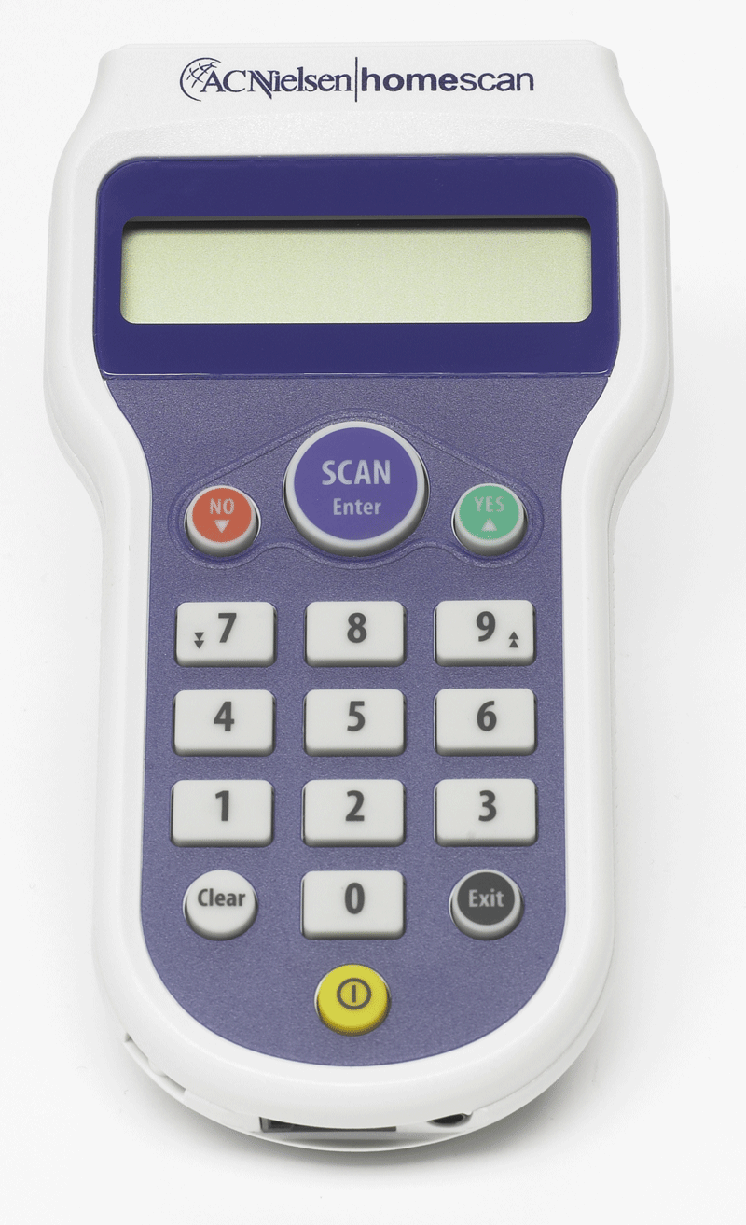
Information Systems in the Enterprise
What is a marketing information system?
Central repository for marketing tasks
Market research system analyzes data gathered from surveys
p. 723 Fig. 14-11
Next

Slide 17
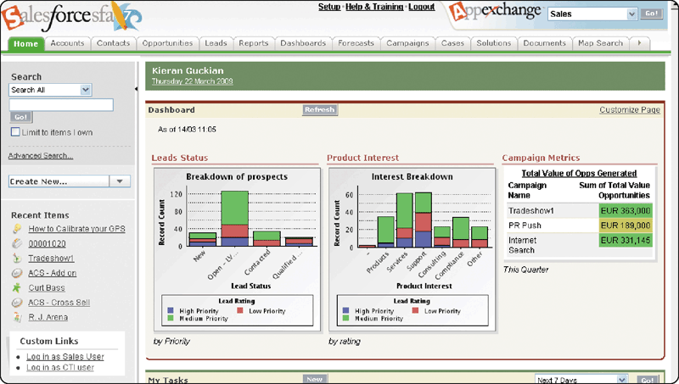
Information Systems in the Enterprise
What is sales force automation (SFA) software?
Tools for traveling salespeople
Runs on notebook computers or other personal mobile devices
Click to view Web Link, click Chapter 14, Click Web Link from left navigation, then click Sales Force Automation below Chapter 14
p. 724 Fig. 14-12
Next

Slide 18
Information Systems in the Enterprise
What are distribution systems?
Provide forecasting for inventory control, and manage and track shipping of products
Provide information and analysis on inventory
p. 724
Next

Slide 19
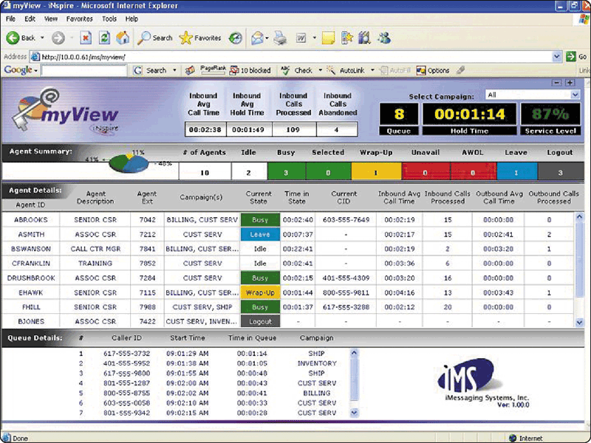
Information Systems in the Enterprise
What is customer interaction management (CIM) software?
Manages interactions with customers
Telephone calls
E-mail
Web interactions
Instant Messaging sessions
p. 724 - 725 Fig. 14-13
Next

Slide 20
Information Systems in the Enterprise
What is information architecture?
Overall technology strategy for an enterprise
IT department uses software to maintain hardware and software
p. 725
Next

Slide 21
Information Systems in the Enterprise
What is an office information system (OIS)?
Enables employees to perform tasks using computers and other electronic devices instead of manually
Sometimes called office automation
Users create graphics and documents, send messages, schedule appointments, browse the Web, and publish Web pages
p. 726
Next

Slide 22

Information Systems in the Enterprise
What is a transaction processing system (TPS)?
Captures and processes data from day-to-day transactions
Transaction— individual business activity
p. 726 - 727 Fig. 14-14
Next

Slide 23
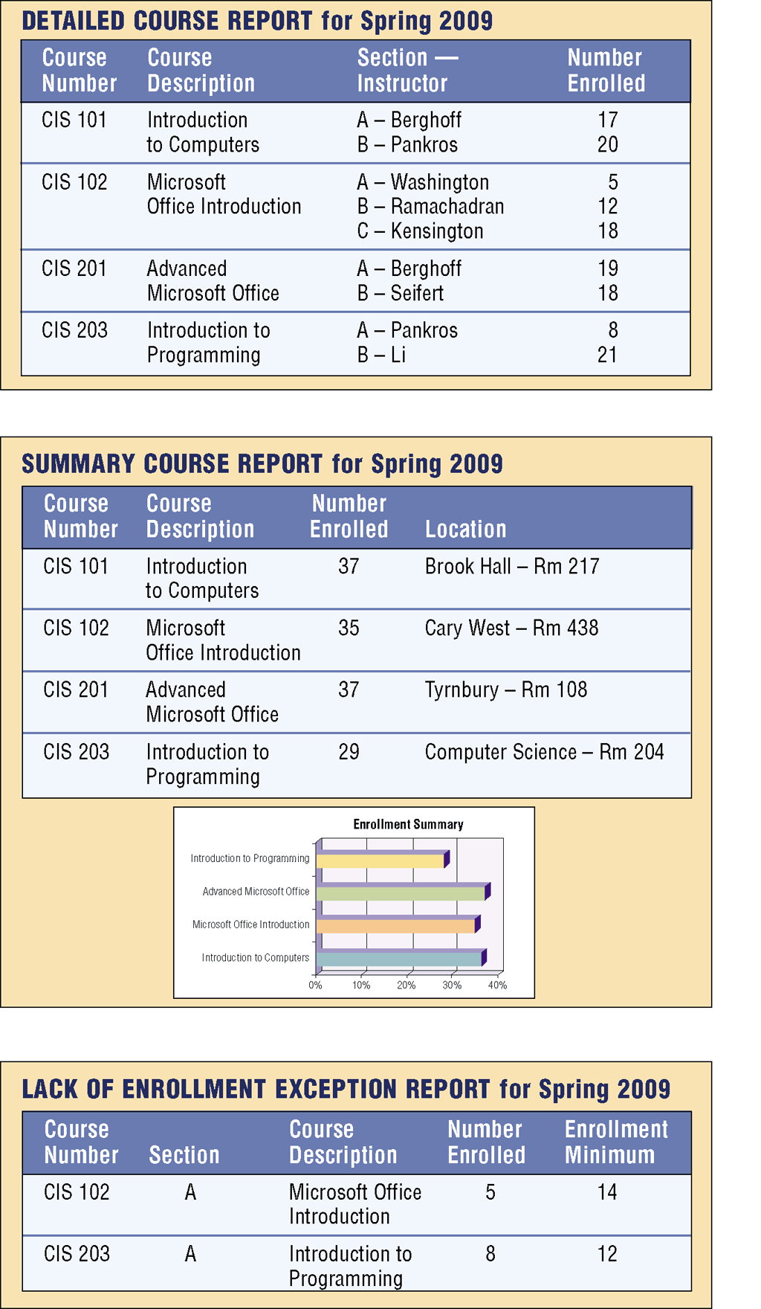
Information Systems in the Enterprise
What is a management information system (MIS)?
Generates accurate, timely, and organized information so that managers can make decisions, solve problems, supervise activities, and track progress
p. 727 Fig. 14-15
Next

Slide 24
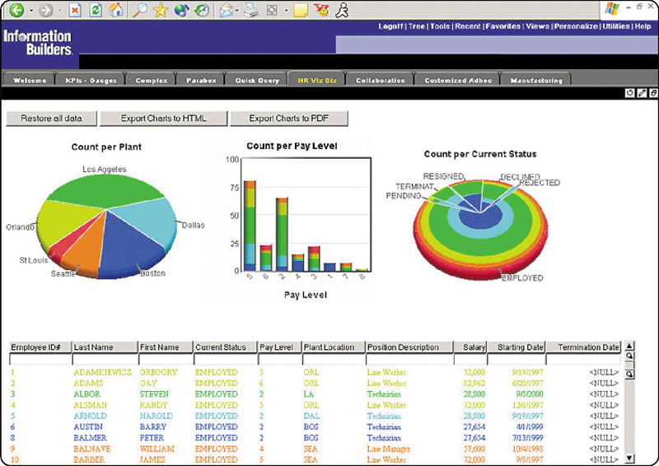
Information Systems in the Enterprise
What is a decision support system (DSS)?
Helps users analyze data and make decisions
Uses data from internal and external sources, as needed
Executive information system (EIS) supports needs of executive management
p. 728 Fig. 14-16
Next

Slide 25
Information Systems in the Enterprise
What is an expert system?
Captures and stores knowledge of human experts and then imitates human reasoning and decision making
Consists of two components
knowledge base—combined subject knowledge and experiences of human experts
inference rules—set of logical judgments applied to the knowledge base
p. 729
Next

Slide 26
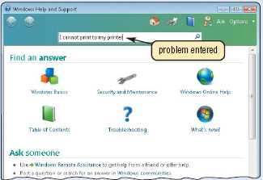
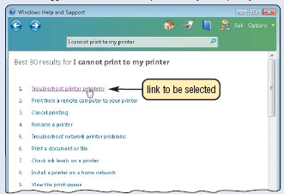
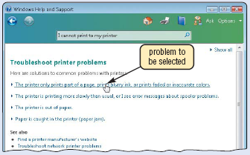
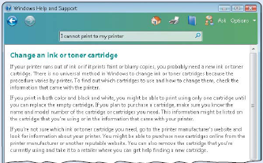
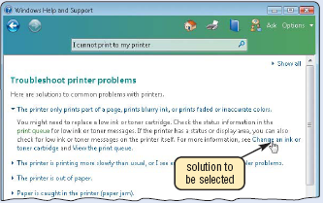
Information Systems in the Enterprise
What is an example of an expert system?
Step 1. A user selects his or her gender
Step 2. Select the location on the body where the problem is being experienced
Step 3. Select the type of pain.
Step 5. Review the possible diagnosis.
Step 4. Select other information about the problem.
p. 729 Fig. 14-17
Next

Slide 27
Information Systems in the Enterprise
What are some common types of expert systems?
Artificial intelligence is application of human intelligence to computers
Knowledge management is process by which enterprise collects, archives, indexes, and retrieves knowledge
Knowledge management software (KMS) assists in the task of knowledge management
p. 730
Next

Slide 28
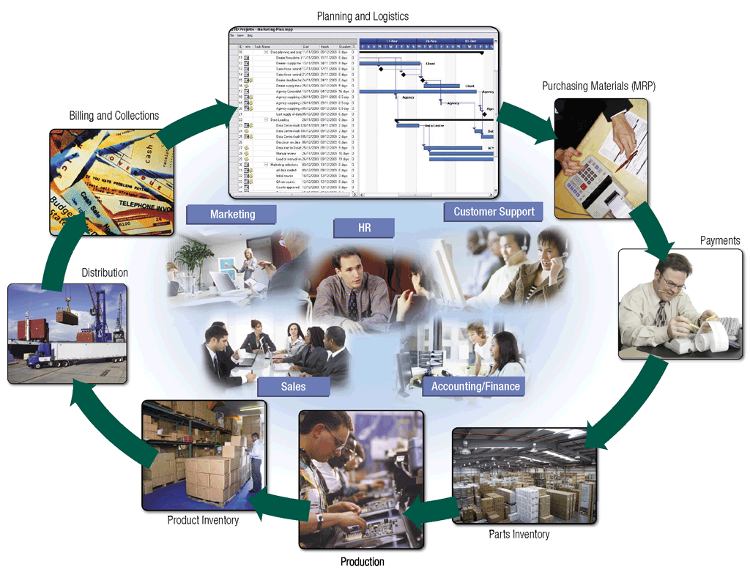
Information Systems in the Enterprise
What is enterprise resource planning (ERP)?
Provides integrated software to coordinate activities of functional units
Click to view Web Link, click Chapter 14, Click Web Link from left navigation, then click Enterprise Resource Planning below Chapter 14
p. 731 Fig. 14-18
Next

Slide 29
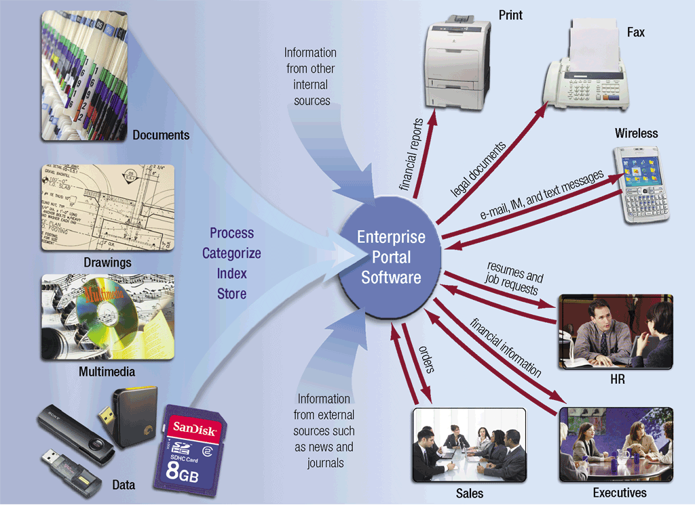
Information Systems in the Enterprise
What is a content management system (CMS)?
Combination of databases, software, and procedures
Organizes and allows access to documents and other files
p. 732 Fig. 14-19
Next

Slide 30
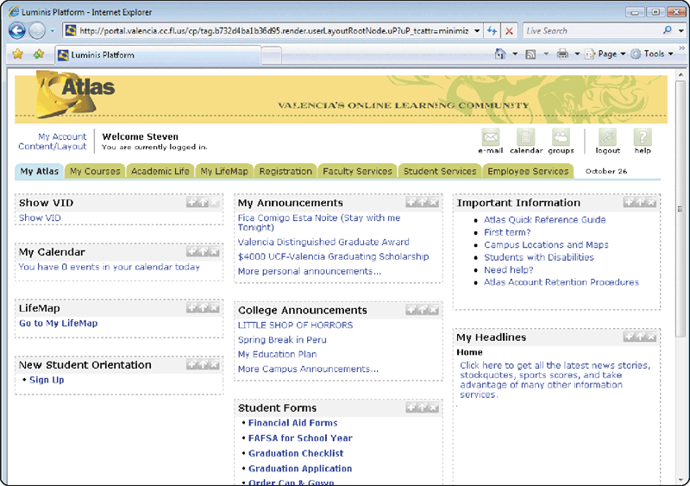
Enterprise-Wide Technologies and Methodologies
What is a portal?
Collection of links, content, and services presented on Web page
Designed to guide users to information they likely are to find interesting for a particular job function
p. 733 Fig. 14-20
Next

Slide 31
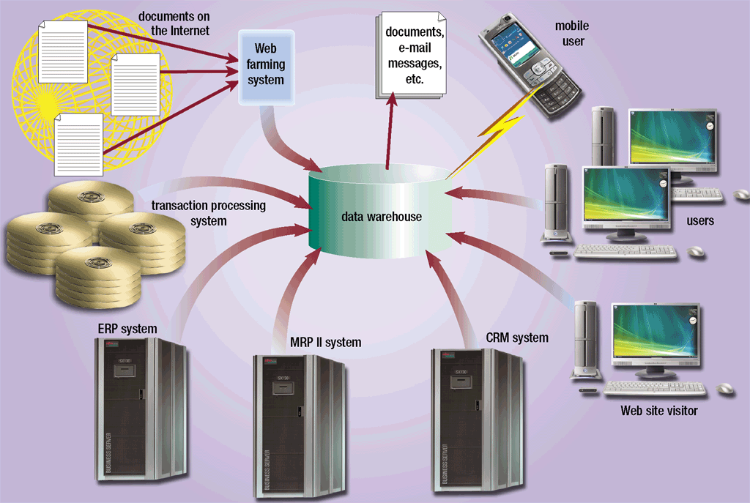
Enterprise-Wide Technologies and Methodologies
What is a data warehouse?
Huge database that stores data required to analyze historical and current transactions
p. 734 Fig. 14-21
Next

Slide 32
Enterprise-Wide Technologies and Methodologies
What is an extranet?
Portion of network that allows customers or suppliers to access parts of enterprise’s intranet
Replaces or supplements existing EDI systems
EDI (electronic data interchange)—Set of standards that controls transfer of business data among computers
p. 735
Next

Slide 33
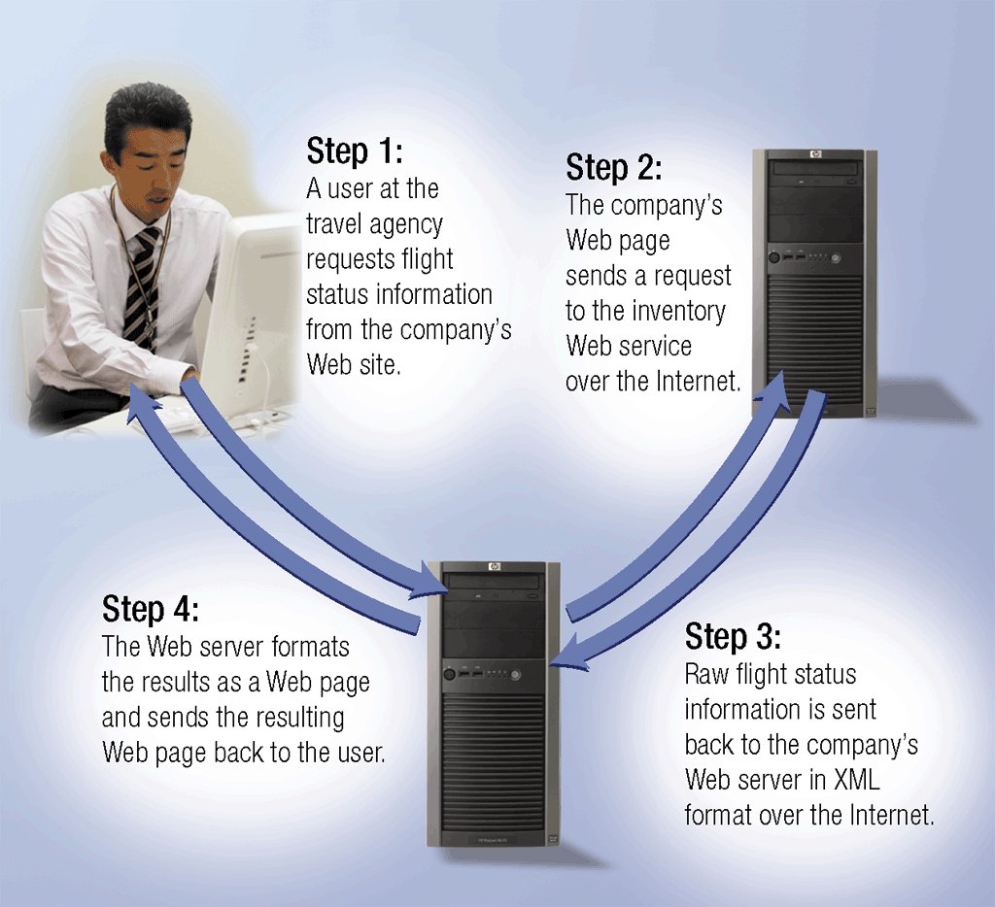
Enterprise-Wide Technologies and Methodologies
What are Web services?
Technologies that allow businesses to create products and B2B (business-to-business) interactions over the Internet
Click to view Web Link, click Chapter 14, Click Web Link from left navigation, then click Web Services below Chapter 14
p. 735 Fig. 14-22
Next

Slide 34
Enterprise-Wide Technologies and Methodologies
What is a workflow?
Steps involved in completing project or business process
Workflow application is a program that tracks process from start to finish
p. 736
Next

Slide 35
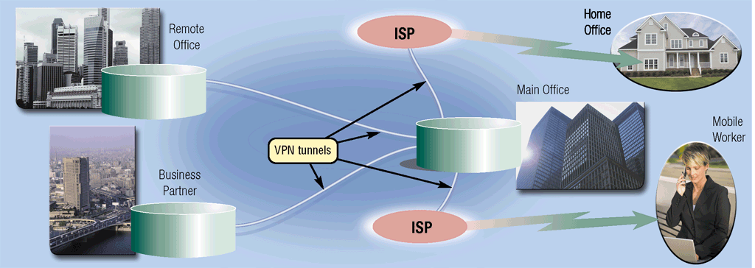
Enterprise-Wide Technologies and Methodologies
What is a virtual private network (VPN)?
Provides secure connection for user connecting to company network server using Internet
p. 736 Fig. 14-23
Next

Slide 36
E-Commerce
What is e-retail?
Retailers use Web to sell products and services
Also called e-tail
Transaction and financial data are verified electronically
p. 737 - 738
Next

Slide 37
E-Commerce
What are online banking and online trading?
Online banking allows users to pay bills and view their bank accounts and statements from their computers
Online trading allows users to invest without using broker, often with a lower transaction fee
p. 738
Next

Slide 38
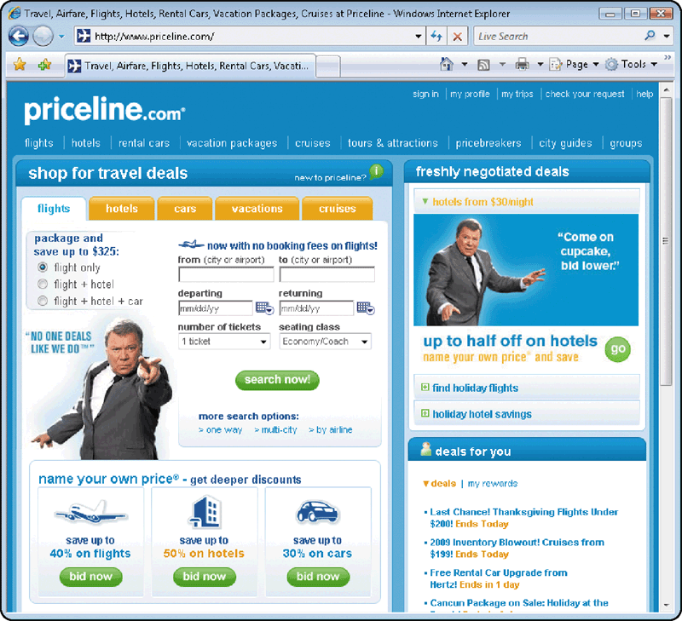
E-Commerce
What entertainment, media, and travel services are on the Web?
Music, videos, news, sporting events, and games
Airline, hotel, and car reservations
Shopping bot—searches for best price on product or service
p. 738 - 739 Fig. 14-25
Next

Slide 39

E-Commerce
Video: New Edge 2.0: Virtually Face to Face
CLICK TO START
Next

Slide 40
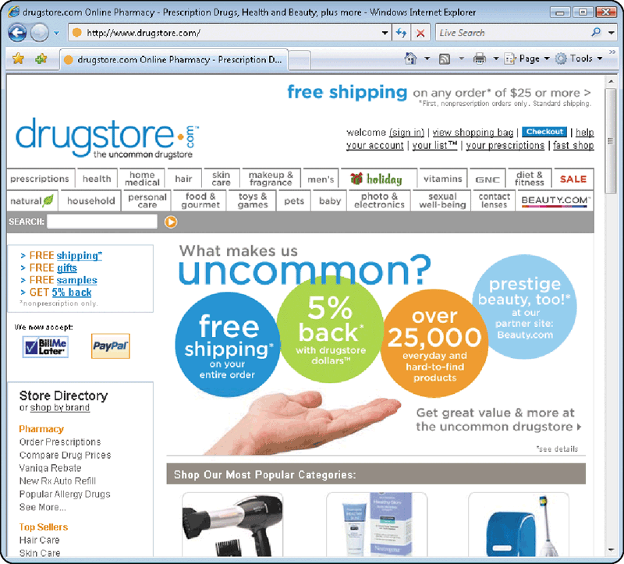
E-Commerce
What health-related information can you find on the Web?
Medical, fitness, nutrition, and exercise
Databases of doctors and dentists, chat rooms, online pharmacies
p. 739 - 740 Fig. 14-26
Next

Slide 41
Enterprise Hardware
What is enterprise hardware?
Allows large organizations to manage and store data
Often includes levels of redundancy
One goal is to maintain high level of availability
Redundancy if one piece breaks, another part can assume tasks
Availability how often hardware is online
p. 741
Next

Slide 42
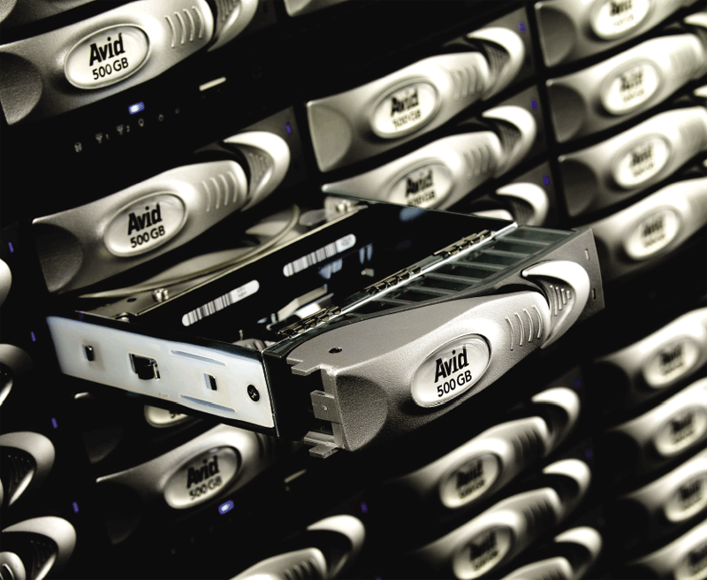
Enterprise Hardware
What is a RAID?
Redundant array of independent disks
Group of two or more integrated hard disks
More reliable than traditional hard disks
Click to view Web Link, click Chapter 14, Click Web Link from left navigation, then click RAID below Chapter 14
p. 741 Fig. 14-27
Next

Slide 43
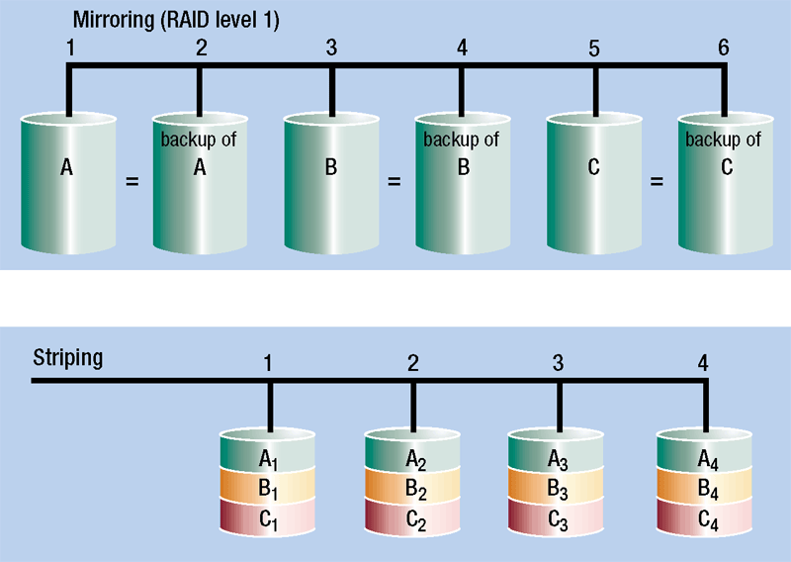
Enterprise Hardware
How does a RAID system work?
Mirroring—writes data on two disks at same time
Enhances reliability
Striping—splits data across multiple disks
Improves access time
Click to view Web Link, click Chapter 14, Click Web Link from left navigation, then click RAID below Chapter 14
p. 741 Fig. 14-28
Next

Slide 44
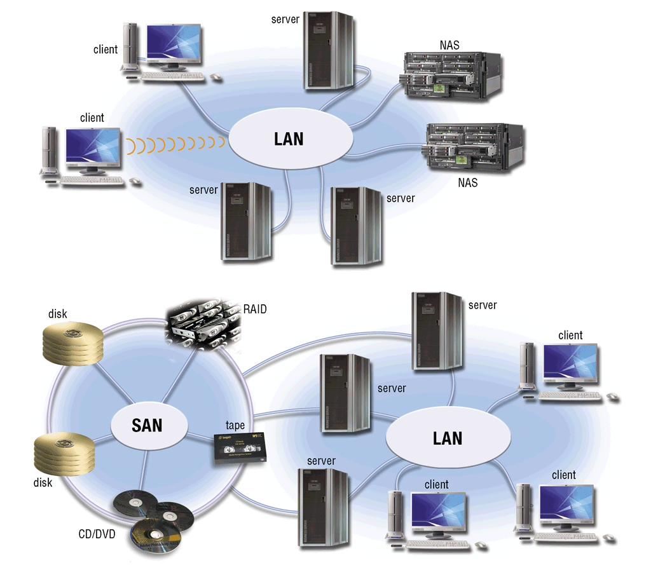
Enterprise Hardware
What is network attached storage (NAS)?
Server that provides storage to users and information systems
Storage area network (SAN) is a high-speed network that provides storage to other servers to which it is attached
Click to view Web Link, click Chapter 14, Click Web Link from left navigation, then click NAS and SAN below Chapter 14
p. 742 Fig. 14-29
Next

Slide 45
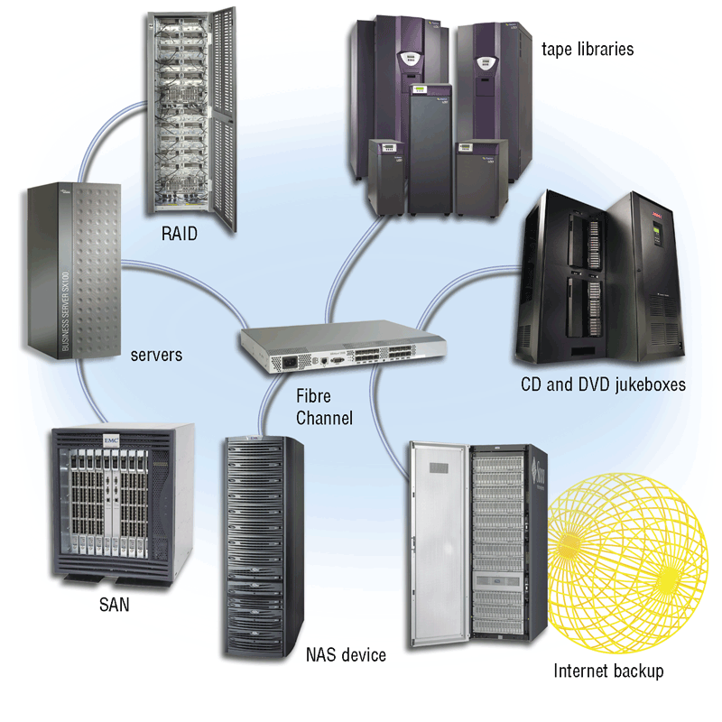
Enterprise Hardware
What is an enterprise storage system?
Strategy that focuses on storage availability, protection, organization, and backup
Uses combination of techniques
CD server, or DVD server, holds hundreds of CDs or DVDs
p. 743 - 744 Fig. 14-30
Next

Slide 46
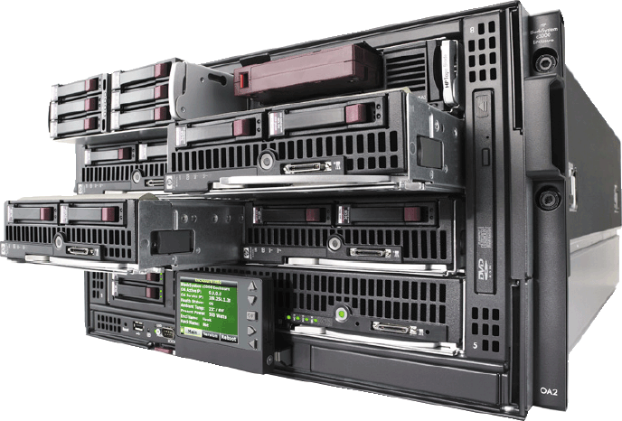
Enterprise Hardware
What is a blade server?
Sometimes called ultradense server
Complete server on single card, or blade, rather than system unit
Saves space, requires less maintenance, uses less energy, generates less heat, and is easily replaced or upgraded
Blade server chassis holds many blades
Click to view Web Link, click Chapter 14, Click Web Link from left navigation, then click Blade Servers below Chapter 14
p. 744 Fig. 14-31
Next

Slide 47
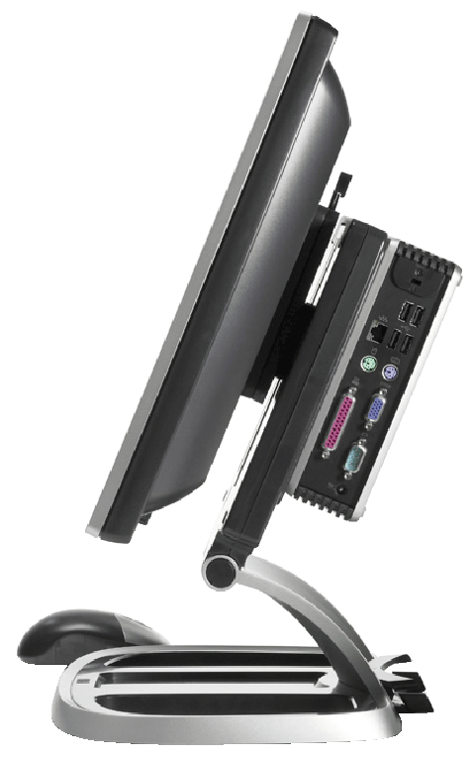
Enterprise Hardware
What is a thin client?
Small terminal-like computers
Mostly rely on a server for data storage and processing
Lack many components typically seen on a personal computer
p. 744 Fig. 14-32
Next

Slide 48
Enterprise Hardware
What are high-availability systems?
Availability (uptime) of at least 99 percent
Often includes hot-swapping
May include redundant components
Hot-swapping allows components to be replaced while rest of system continues to perform tasks
Redundant component takes over task of similar component that fails
p. 745
Next

Slide 49
Enterprise Hardware
What are scalability and interoperability?
Scalability is measure of how well computer hardware, software, or information system can grow to meet increasing needs
Interoperability is ability to share information with other information systems within enterprise
Adding hardware is often easiest method to grow
System that shares information easily is said to be open
p. 745 - 746
Next

Slide 50
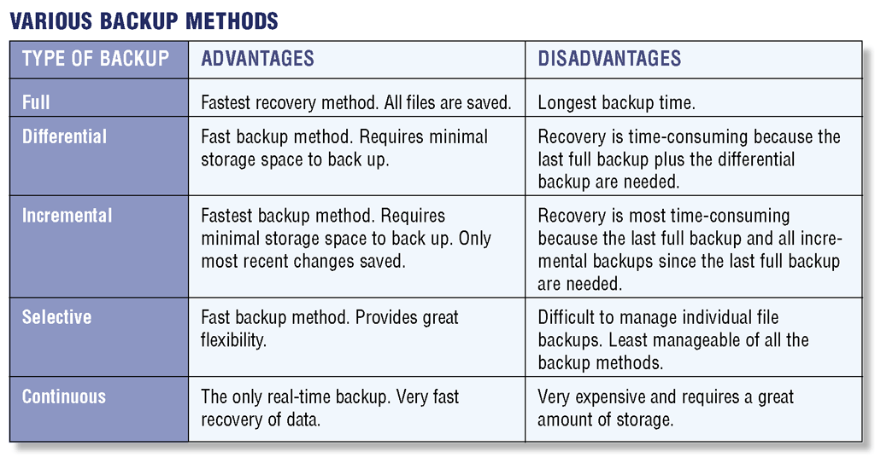
Backup Procedures
What are the five types of backups?
p. 747 Fig. 14-33
Next

Slide 51
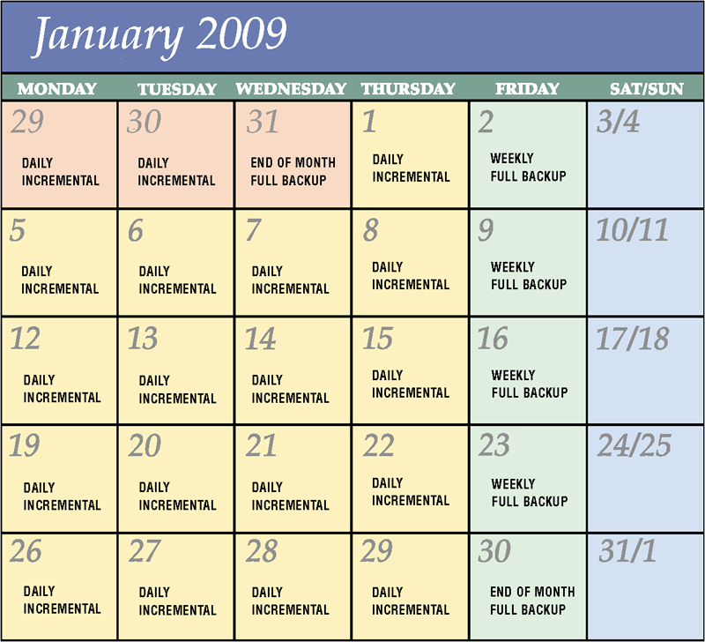
Backup Procedures
What is a backup procedure?
Regular plan of copying and storing data and program files
Can use combination of full backups and differential or incremental backups
p. 746 - 747 Fig. 14-34
Next

Slide 52
Backup Procedures
What is a disaster recovery plan?
Written plan for restoring computer operations in event of disaster
Backup plan how backup files and equipment would be used to resume information processing
Emergency plan steps to be taken immediately after disaster
Recovery plan actions to be taken to restore full information processing operations
Test plan simulates various levels of disasters and records ability to recover
p. 747 - 749
Next

Slide 53
Summary of Enterprise Computing
Special computing requirements present in an enterprise-sized organization
Requirements for enterprise hardware including high-availability, scalability, and interoperability
E-retailing and types of businesses that use e-commerce
Backup procedures present in a large organization
Complex hardware including SANs, RAID, and blade servers
Chapter 14 Complete

